Slide 1

AJAX Patterns
Predictive Fetch
Aruna S
Department of
Computer Science and Engineering

Slide 2

AJAX PATTERNS
Predictive Fetch
S. Aruna
Department of Computer Science and Engineering

Slide 3
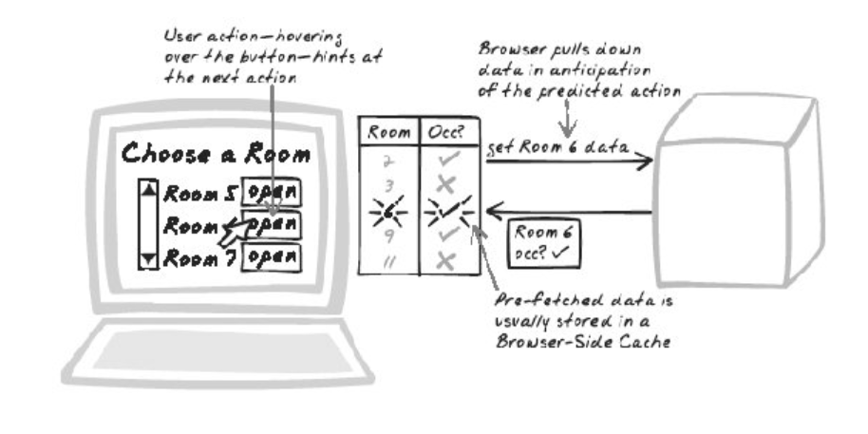
AJAX Patterns
Predictive Fetch
How can you make the system respond quickly to user activity?

Slide 4
AJAX Patterns
Predictive Fetch Applications
The user's navigating a Virtual Workspace such as a large table. Pre-fetch the results of moving in each direction.
The user's converting between two currencies. Pre-fetch the major currency rates.
The user's reading some articles. Pre-fetch all stories in the favorite category.
Google Maps

Slide 5
AJAX Patterns
Predictive Fetch Decision Factors
How much information will be pre-fetched?
Will it be the server or the browser that anticipates user actions?
What information can be used to anticipate user actions?
User's profile
User's current activity
Activity of other users
Collaborative filtering

Slide 6
THANK YOU
Aruna S
Department of
Computer Science and Engineering
arunas@pes.edu

